Slide 1

Target Intelligence Packet
Mirwas "The Engineer" Khan

Slide 2
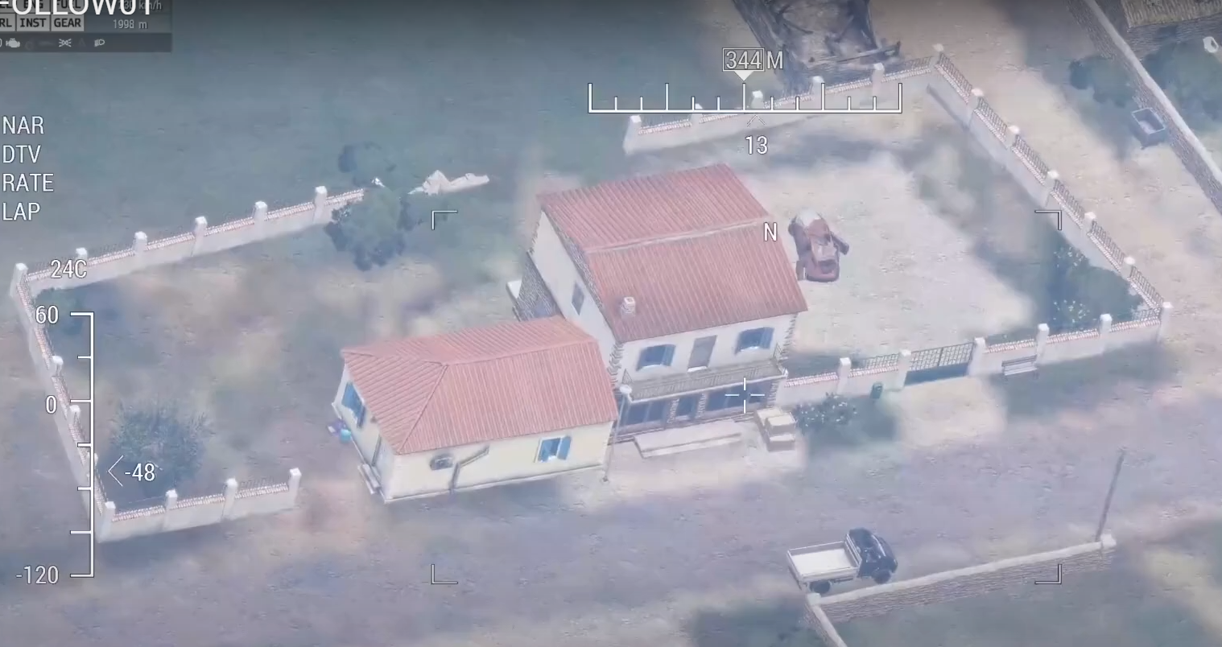
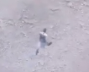

TARGET: Mirwais "The Engineer" Khan
UNCLASSIFIED
UNIT: SMX
TARGET NUMBER: TGT-0001
COUNTRY: Afghanistan
AREA OF OPERATION: Balkh, Kunduz, Samagan
DOI: 15 JUN 2025
MGRS: 33T XE 14367 17683
TASK: KILL / CAPTURE
PHYSICAL DESCRIPTION
PHYSICAL DESCRIPTION
PROB BED DOWN LOCATION
SEX: MALE
AGE: 30-35
BODY COMP: ATHLETIC
EYES: BROWN
HAIR: BROWN
OTHER DETAILS: Wears traditional Afghan clothing. May have chemical stains/burns on hands and forearms.
TARGET INFORMATION
Target Role: IED Facilitator, Technical Advisor, Trainer
Impact: Disrupts Northern Province's IED production
Possible Alias: "The Engineer", Abu Ibrahim al-Afghani
Known Movements: Travels from BDL to Mazar-e Shariff weekly
Affiliations
Family: Fatimah (Wife, 35), Khalid (Son, 12), Hassan (Son, 8)
Vehicles: Blue Bongo with white bed, Red Tuk Tuk
Religion: Islam
Ethnicity: Pashtun
TARGET SUMMARY: Mirwais "The Engineer" Khan is a suspected mid-level IED facilitator believed to be responsible for the technical development, production, and emplacement of sophisticated IEDs targeting Afghan National Security and Defense Forces (ANDSF) and coalition personnel in the northern provinces. His expertise in electronics and explosives, combined with his deep understanding of the local terrain and tribal networks, makes him a significant threat to regional stability. Intelligence suggests Khan is not directly aligned with a single insurgent group but operates as a semi-independent contractor, providing his services to the highest bidder, thereby increasing the lethal capabilities of multiple networks.
SOURCES: HUMINT, IMINT
TRIGGER: IMINT
UNCLASSIFIED
Last updated with: HUMINT
TARGET NUMBER: TGT-00001 COUNTRY:: Afghanistan Area of Operation: Balkh, Kunduz, Samagan Trigger: IMINT
Notes:
Resize and line up the "Target Number" box to the baseball card above

Slide 3

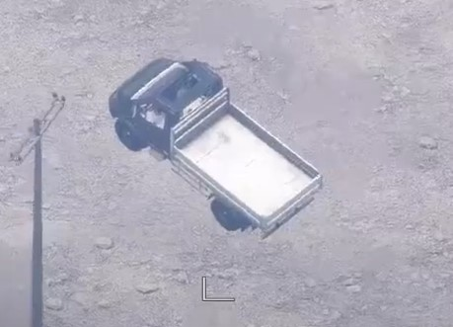
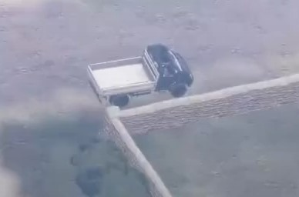
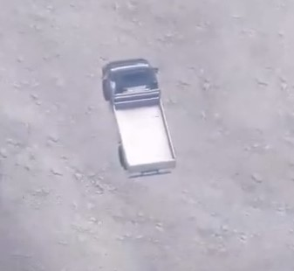
CALLSIGN: MISFIT01
OPN DARK LAB | AFG
DTG: 200701ZJUN25
MGRS: 33T XE 14367 17683
UNCLASSIFIED
Vehicle of Interest
B
G
C
A
A
B
G
E
F
D
ANNOTATION
F
C
E
ANNOTATION
A
D
G
B
C
VEHICLE CHARACTERISTICS
A | BLUE BONGO | D | BLACK TIRES W/ BLACK RIMS | G | SUNROOF
B | HEADACHE RACK | E | SILVER SIDESTEP
C | WHITE BED | F | WHITE INTERIOR
D
A
D
G
B
E
C
F
Notes:
What's "VOI" stand for? - May or may not need to be typed out in full with (VOI) following.

Slide 4
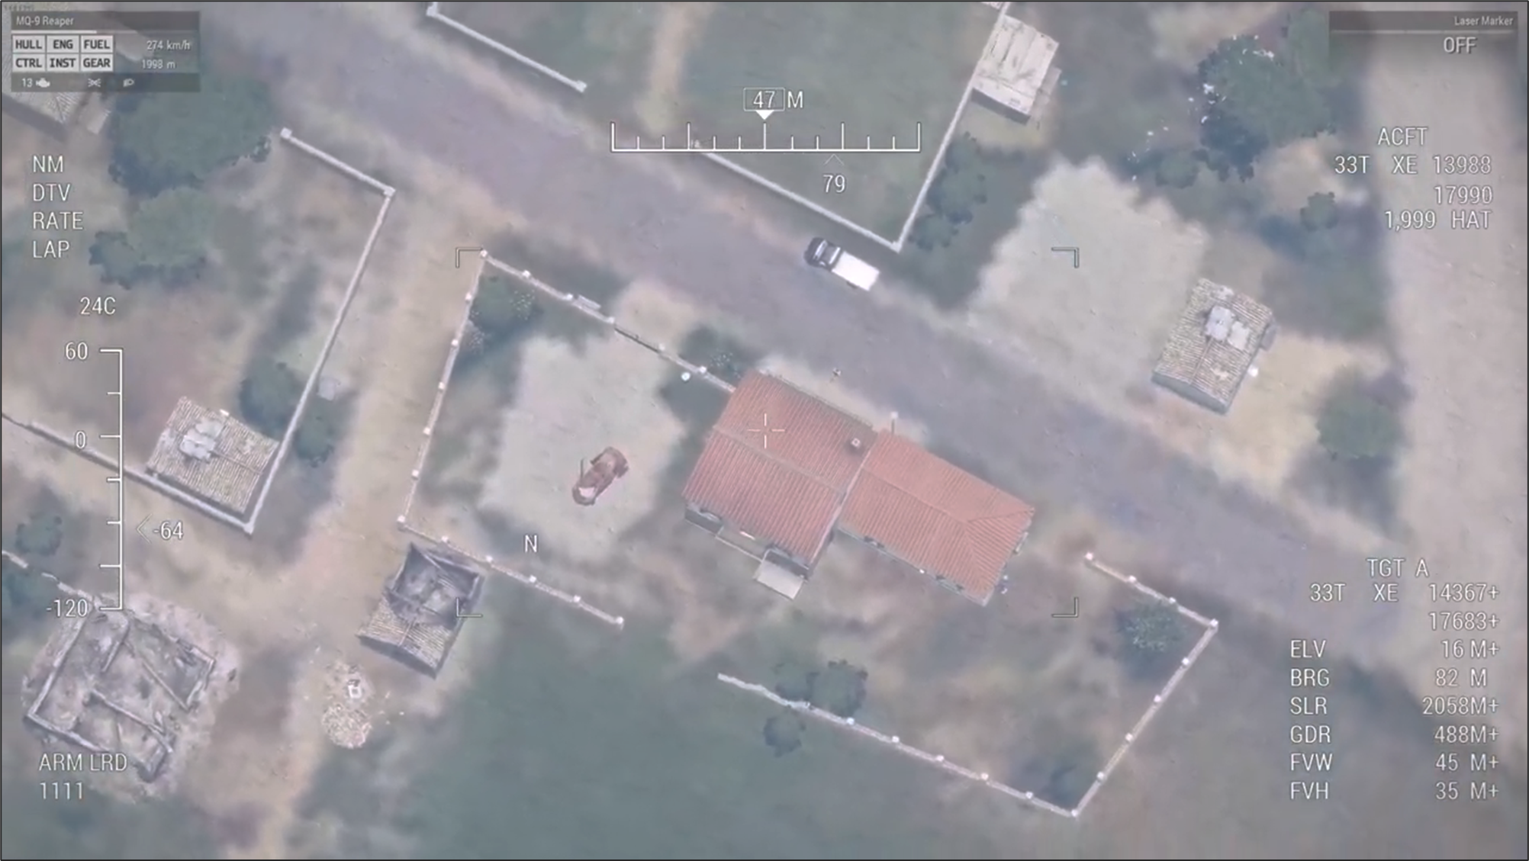
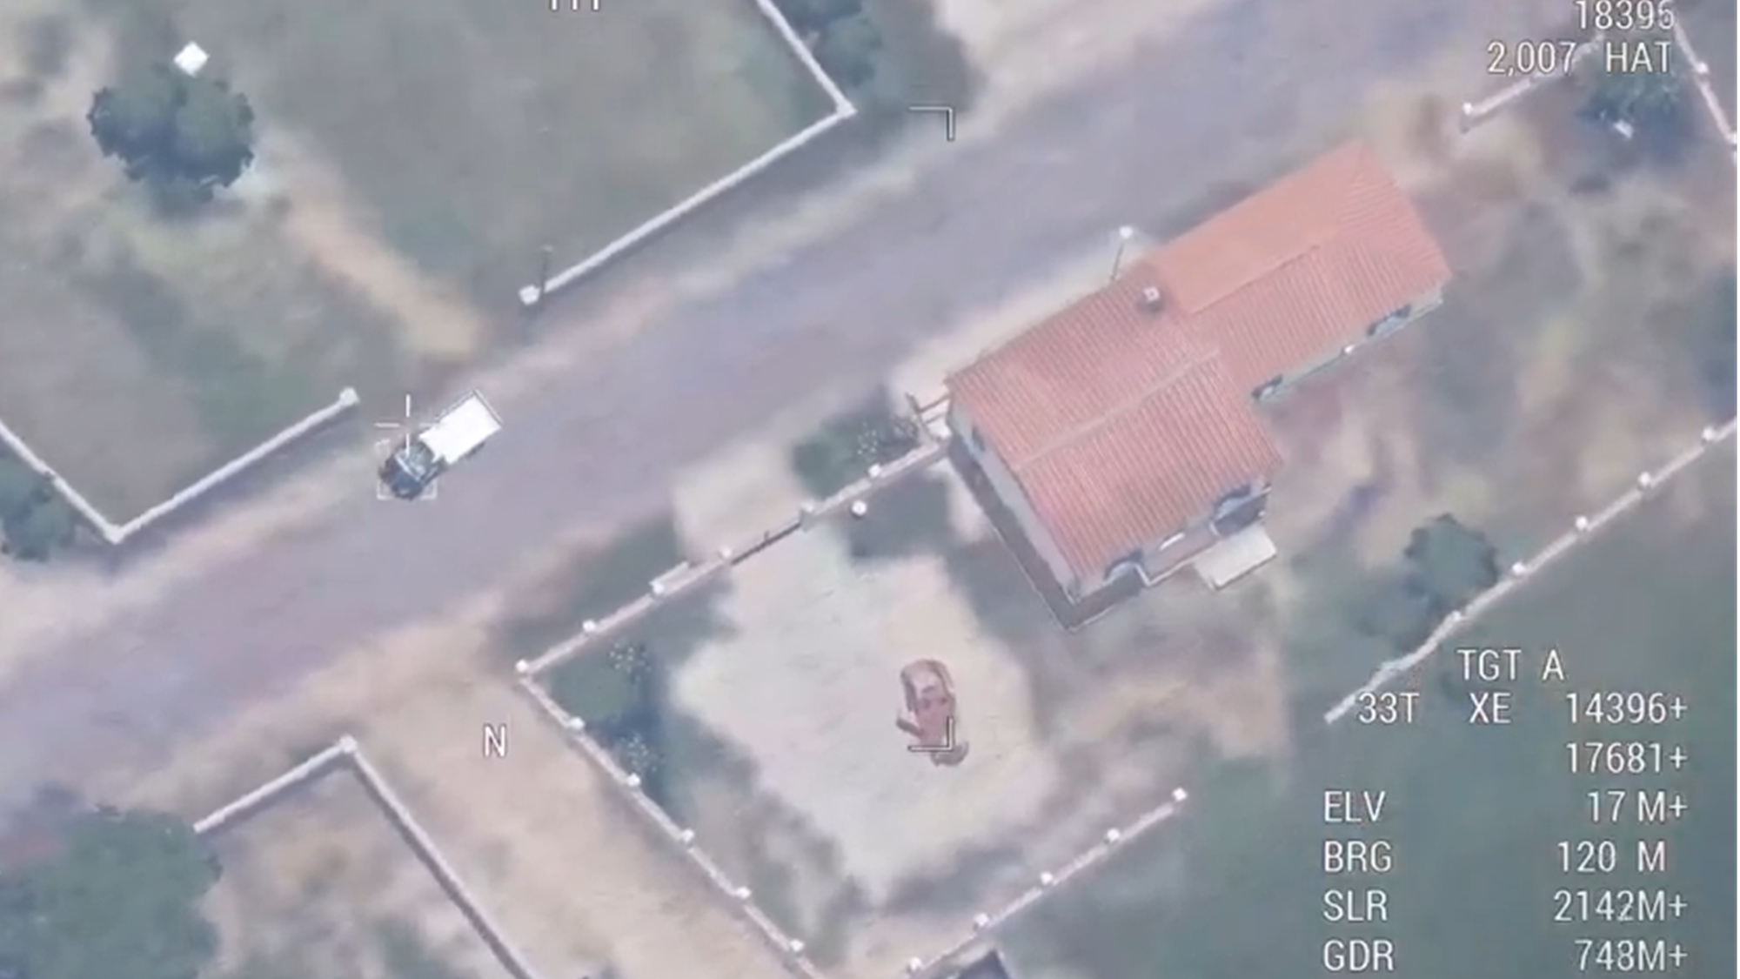
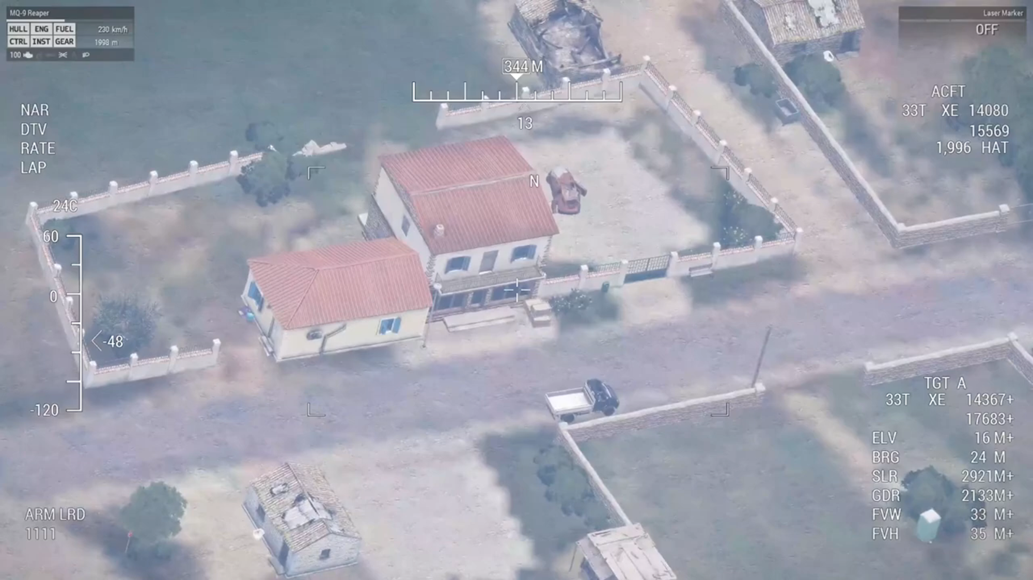
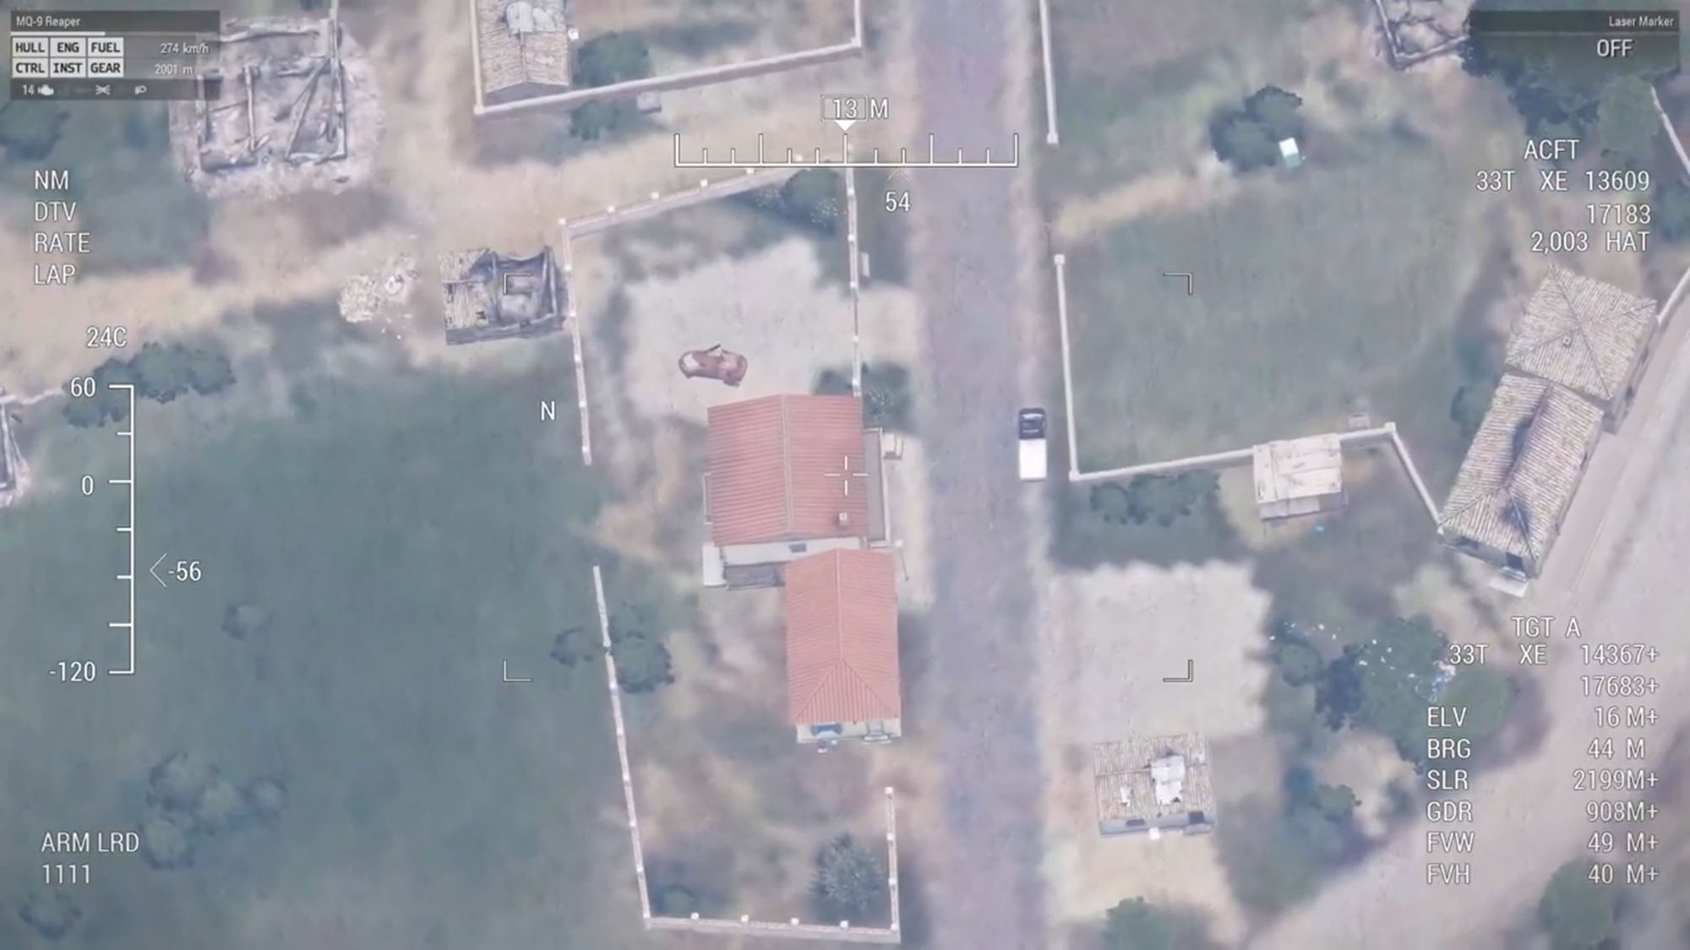
CALLSIGN: MISFIT01
OPN DARK LAB | AFG
DTG: 200701ZJUN25
MGRS: 33T XE 14367 17683
UNCLASSIFIED
Compound Overview 360
NORTH SIDE
EAST SIDE
N
N
SOUTH SIDE
WEST SIDE
N
N
UNCLASSIFIED

Slide 5
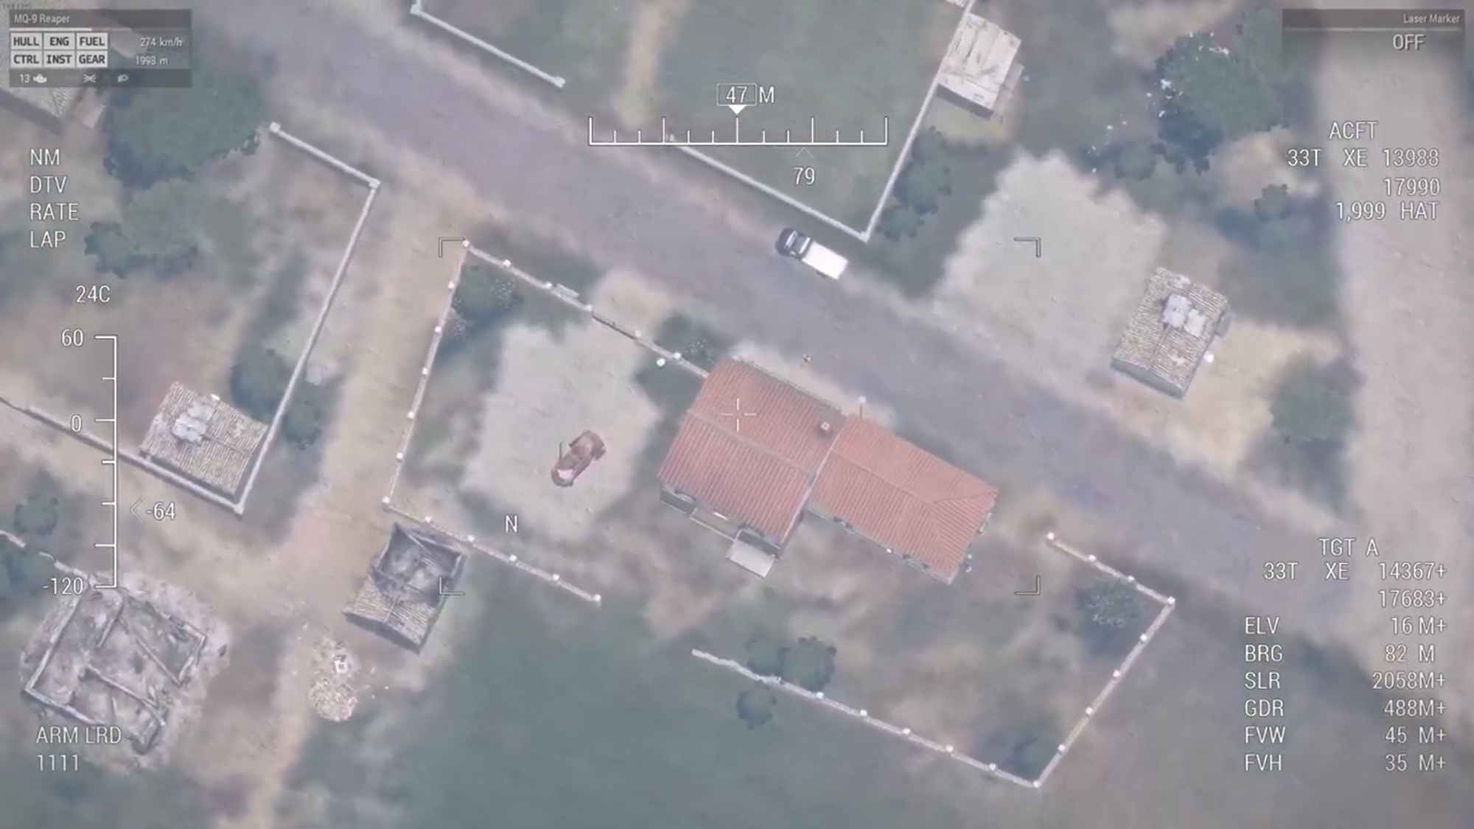
CALLSIGN: MISFIT01
OPN DARK LAB | AFG
DTG: 200701ZJUN25
MGRS: 33T XE 14367 17683
UNCLASSIFIED
N
Compound North Side
MAIN RESIDENCE
Perimeter
Entrances
Windows
UNCLASSIFIED

Slide 6
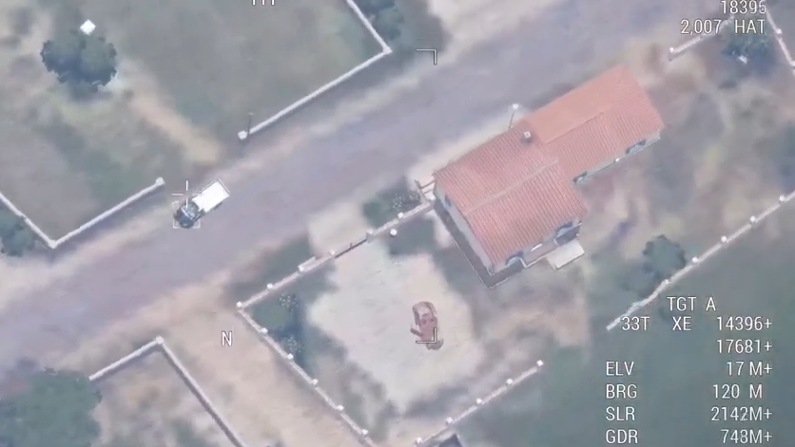
CALLSIGN: MISFIT01
OPN DARK LAB | AFG
DTG: 200701ZJUN25
MGRS: 33T XE 14367 17683
UNCLASSIFIED
N
Compound East Side
MAIN RESIDENCE
Perimeter
Entrances
Windows
DERELICT VEHICLE
UNCLASSIFIED

Slide 7

CALLSIGN: MISFIT01
OPN DARK LAB | AFG
DTG: 200701ZJUN25
MGRS: 33T XE 14367 17683
UNCLASSIFIED
N
Compound South Side
MAIN RESIDENCE
VEHICLE GATE
Perimeter
Entrances
Windows
Rooftop Access
UNCLASSIFIED
Notes:
The rooftop access annotation – windows are also rooftop access points; reconsideration of annotations

Slide 8

CALLSIGN: MISFIT01
OPN DARK LAB | AFG
DTG: 200701ZJUN25
MGRS: 33T XE 14367 17683
UNCLASSIFIED
N
Compound West Side
COMPOUND
Perimeter
Entrances
Windows
UNCLASSIFIED

